Slide 1
FASTAPI Development using Python on Cloud
FastAPI with Agentic AI on Cloud

Slide 2
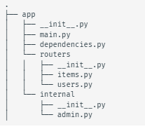
Multiple File Structure in FastAPI
If you are building an application or a web API, it's rarely the case that you can put everything in a single file.
FastAPI provides a convenience tool to structure your application while keeping all the flexibility

Slide 3
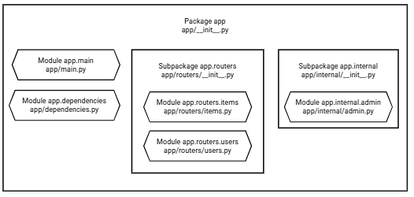
Multiple File Structure in FastAPI

Slide 4
APIRouter
Let's say the file dedicated to handling just users is the submodule at /app/routers/users.py.
You want to have the path operations related to your users separated from the rest of the code, to keep it organized.
But it's still part of the same FastAPI application/web API (it's part of the same "Python Package").
You can create the path operations for that module using APIRouter.

Slide 5
Dependencies in FastAPI
In FastAPI, you can apply dependencies to all routes within an APIRouter using the dependencies parameter of the APIRouter class. This is an efficient way to manage shared logic such as authentication, database connections, or logging for a group of related endpoints without repeating code in each path operation function.
Define your dependency function(s): These are standard FastAPI dependencies, which can be async or def functions, or classes, that often use Depends() themselves.
Create an APIRouter instance and pass your dependencies as a list to the dependencies argument.
Include the router in your main FastAPI application.

Slide 6
Benefits of Dependencies in APIRouter
Execution Order: Router-level dependencies are executed before dependencies defined directly in the path operation function's decorator or function parameters.
Return Values: By default, the return values of dependencies specified in the dependencies list of the APIRouter (or app.include_router()) are not automatically passed as parameters to the path operation function. They are primarily for side effects, such as authentication checks, logging, or ensuring a resource is available.
Accessing Return Values: If you need to access the return value of a router-level dependency within your path function (e.g., getting the current_user object after authentication), you must explicitly declare that same dependency in the path operation function's parameters. FastAPI is smart enough to call the dependency only once per request and cache the result.
Overriding: Dependencies can be overridden for testing purposes using the app.dependency_overrides attribute, which simplifies unit testing of individual routes.
Dependencies with yield: The APIRouter supports dependencies with yield, which are useful for resource management like database sessions, ensuring cleanup code runs after the request is finished.

Slide 7
Overview of Alembic
Alembic provides for the creation, management, and invocation of change management scripts for a relational database, using SQLAlchemy as the underlying engine.
Usage of Alembic starts with creation of the Migration Environment. This is a directory of scripts that is specific to a particular application.
The migration environment is created just once and is then maintained along with the application’s source code itself. The environment is created using the init command of Alembic and is then customizable to suit the specific needs of the application.

Slide 8
Alembic Benefits
Version Control for Your Database: Alembic acts like "Git for your database schema," allowing you to track every change (e.g., adding a table, renaming a column) as an explicit, versioned step in a migration script. This provides a clear, auditable history of modifications.
Consistency Across Environments: It ensures that every developer, testing environment, and the production database uses the exact same schema evolution process. This eliminates "schema drift" and prevents issues caused by manual errors during deployment.
Safe Upgrades and Downgrades (Rollbacks): Each migration script contains instructions for both applying the changes (upgrade) and reversing them (downgrade). This provides a crucial safety net, allowing you to revert to a previous, stable state if a new release encounters problems.
Streamlined Collaboration: Each developer's schema changes are captured in migration files that are checked into the source code repository. Team members can easily pull the latest changes and run a single command to sync their local databases.
Automation and CI/CD Integration: Migrations can be easily integrated into Continuous Integration/Continuous Deployment (CI/CD) pipelines, automating the process of applying database changes during deployment. This makes releases more reliable and predictable.
Pythonic API and SQLAlchemy Integration: Migration scripts are written in Python, allowing developers to leverage the full power and readability of Python code. It works hand-in-hand with SQLAlchemy, the most popular Python ORM, and can automatically generate draft migration scripts based on model definitions.
Database Agnostic: Alembic supports all major databases that SQLAlchemy works with, including PostgreSQL, MySQL, and SQLite, making it a versatile choice for diverse projects.

Slide 9
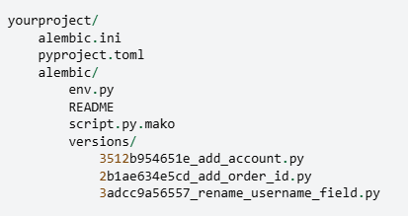
Directory Structure
Alembic.ini -> This is Alembic’s main configuration file which is generated by all templates.
Pyproject.toml – Alembic may store optionally project related configuration.
Yourproject – root of the application.
Alembic – The directory lives within the application source tree and source of migration.
env.py – part of generated environment so that the migration runs are entirely customizable.

Slide 10
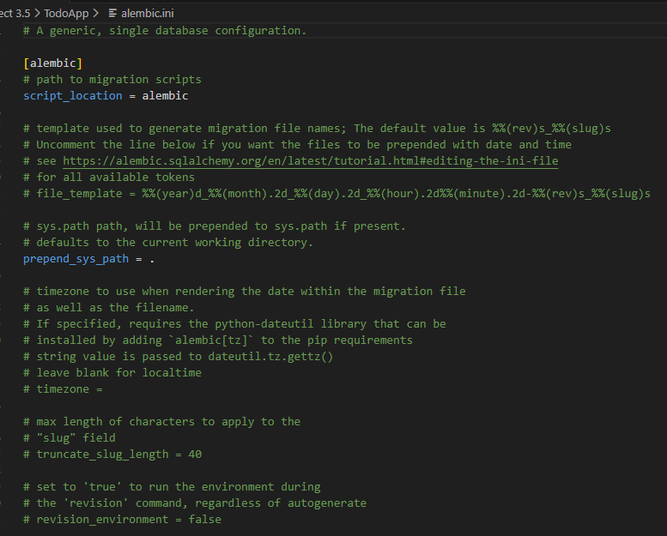
Alembic .ini file

